Slide 1

Recursion Tree Analysis for Polynomial Combine Cost
Recurrence Relation:
CSA0614 - Design and Analysis of Algorithms
Nirmal Kasi 192424248
B.Tech Artificial Intelligence And Data Science

Slide 2

Problem Statement
Problem
Analyze the recurrence
using the Recursion Tree Method.
Objectives
Construct the recursion tree.
Calculate the cost at each level.
Find the total running time.
Verify the answer using the Master Theorem.
Compare both methods.

Slide 3

Algorithm Overview
The recursion tree represents every recursive call as a node.
Steps
Expand recursive calls.
Find the work done at each level.
Count the number of levels.
Add all level costs.
Simplify the summation.
The combine cost at every node is:

Slide 4

Algorithm / Pseudocode
Function T(n)
If n = 1
return 1
Else
Divide problem into 4 subproblems
Solve each subproblem recursively
Combine solutions with cost n²
Return total cost
Recurrence:

Slide 5
Working Example (Dry Run)
Recursion Tree
Level Costs
n²
/ | | \
4 × (n/2)²
/ / / / ...
16 × (n/4)²
/ / / ...
64 × (n/8)²
Level | Number of Nodes | Cost per Node | Total Cost
0 | 1 | n² | n²
1 | 4 | (n/2)² | n²
2 | 16 | (n/4)² | n²
3 | 64 | (n/8)² | n²
k | 4ᵏ | (n/2ᵏ)² | n²
Observation:
Each level contributes exactly

Slide 6
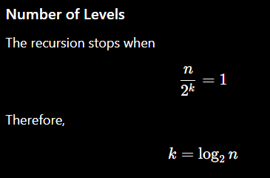
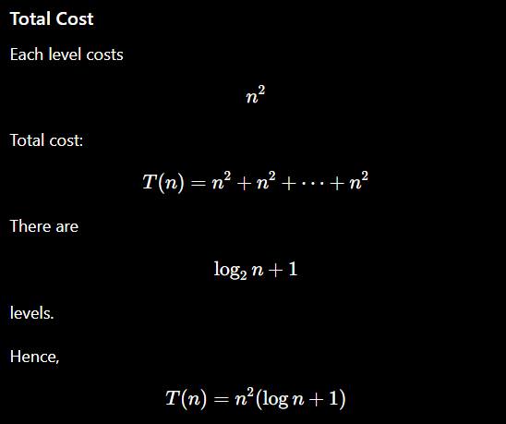
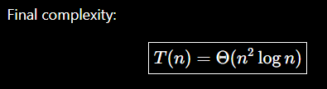
Complexity Analysis

Slide 7
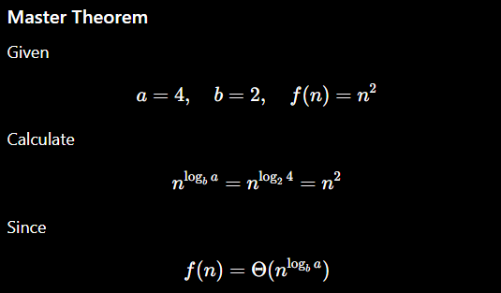
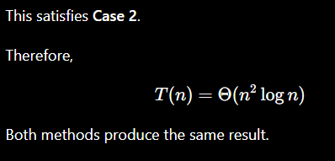
Comparative Analysis
Method | Result
Recursion Tree | Θ(n² log n)
Master Theorem | Θ(n² log n)

Slide 8
Applications
Recurrences of this form appear in:
Merge-based algorithms with expensive merging
Matrix computations
Image processing
Parallel divide-and-conquer algorithms
Scientific computing
Computational geometry

Slide 9

Results & Discussion
Result
Using recursion tree analysis
Discussion
Every level performs equal work.
There are logarithmic levels.
Total cost grows as
Recursion Tree provides visual understanding.
Master Theorem provides a faster mathematical verification.

Slide 10

Conclusion & References
Conclusion
The recurrence was analyzed using the Recursion Tree Method.
Every level contributes n² work.
The tree has log₂n levels.
Total complexity is
The result matches Master Theorem Case 2.

